Slide 1
Neural Network Zoo

Slide 2
Agenda
Introduction
The Zoo Concept
Interactive Group Activity & Research
Reflection and Deeper Understanding
Application & takeaways

Slide 3
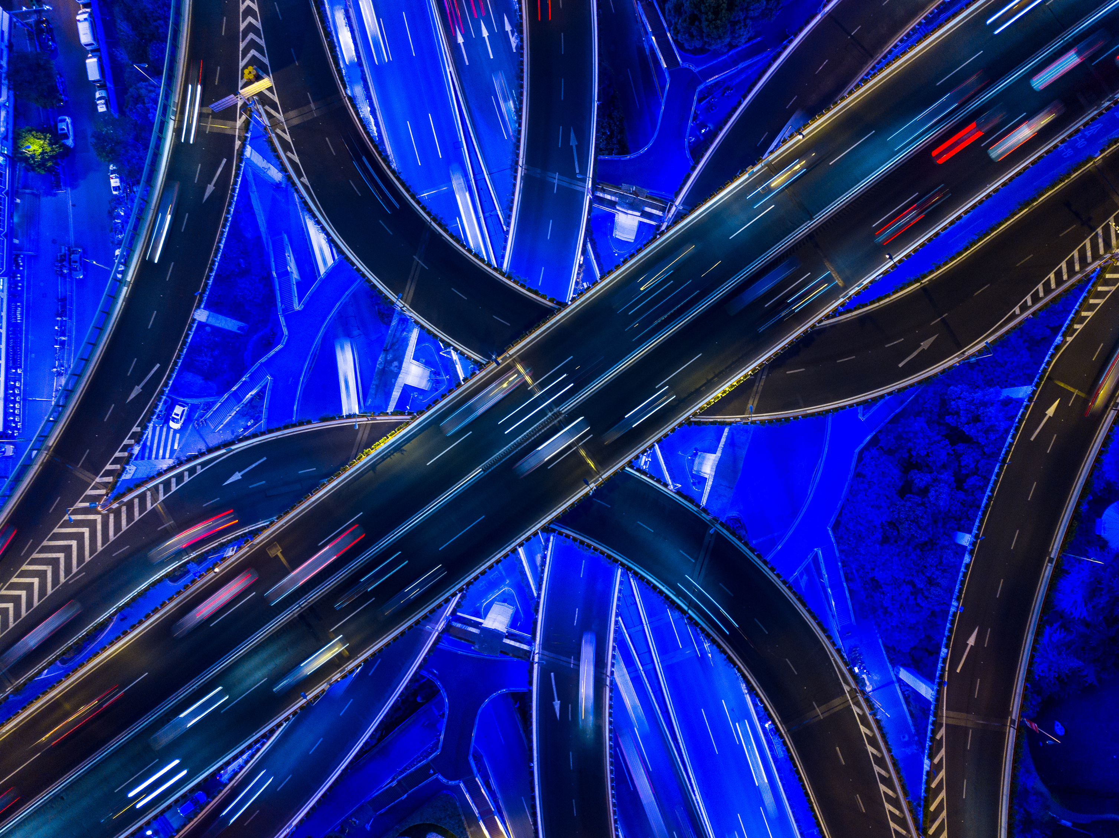
Introduction to Neural Networks

Slide 4
Neural Network in simple terms​
Neural networks, also known as artificial neural networks (ANNs), lie at the heart of deep learning algorithms. Inspired by the intricate signaling between biological neurons in the human brain, these networks aim to mimic that remarkable functionality.
Basic Structure of a Neuron
Imagine a neuron as a tiny computational unit. Each neuron receives input signals, processes them, and produces an output. Here’s a simplified view of a neuron:
Input: Neurons receive input data from other neurons or external sources.
Weights: Each input is associated with a weight, representing its importance.
Summation: The weighted inputs are summed up.
Activation Function: The result passes through an activation function, determining whether the neuron “fires” (activates) or remains inactive.
Neurons are organized into layers, forming a neural network. The layers typically include:
Input Layer: Receives raw data.
Hidden Layers: Process information and learn complex patterns.
Output Layer: Produces the final result (e.g., classification, prediction).

Slide 5
The Zoo Concept: Neural Network Animals​
Let’s introduce our “Neural Network Zoo,” where each type of neural network is represented as an animal.
Convolutional Neural Network (CNN) Cheetah: Known for its lightning-fast image recognition skills, the CNN specializes in visual tasks like identifying objects in photos.
Recurrent Neural Network (RNN) Raccoon: The RNN excels at sequential data, such as natural language processing and time-series predictions.
Long Short-Term Memory (LSTM) Lemur: The LSTM, like its namesake, has an excellent memory. It’s ideal for handling long sequences and maintaining context.

Slide 6
The CNN Cheetah: A Swift Hunter of Visual Patterns
Structure:
Input Layer: The CNN Cheetah receives raw image data. Each pixel is like a blade of grass in the savanna.
Convolutional Layers: These layers detect local patterns (edges, textures) in the image. Imagine them as the cheetah’s keen eyes spotting prey.
Pooling Layers: Like the cheetah’s powerful strides, these layers downsample the data, reducing its size.
Fully Connected Layers: These layers process the high-level features and make predictions. They’re the cheetah’s brain, deciding whether to pounce or wait.
How It Functions:
Feature Extraction: The CNN Cheetah scans the image, looking for edges, corners, and textures. It learns to recognize shapes and patterns.
Weight Sharing: Just as cheetahs share hunting techniques, CNN layers share weights. This reduces the number of parameters and speeds up learning.
Spatial Hierarchies: The CNN Cheetah builds a hierarchy of features. Early layers detect simple edges; deeper layers recognize complex shapes.
Activation Functions: These decide if a neuron “fires.” Like a cheetah’s muscles contracting, they determine whether a feature is present.
Typical Applications:
Image Classification: The CNN Cheetah excels at identifying objects in images. It can tell a lion from a gazelle!
Object Detection: It spots multiple objects in an image—like a cheetah scanning the grasslands for prey.
Face Recognition: Just as cheetahs recognize each other, CNNs recognize faces.
Medical Imaging: Detecting tumors or anomalies in X-rays and MRIs.

Slide 7
The CNN Cheetah: A Swift Hunter of Visual Patterns....2
Typical Applications:
Image Classification: The CNN Cheetah excels at identifying objects in images. It can tell a lion from a gazelle!
Object Detection: It spots multiple objects in an image—like a cheetah scanning the grasslands for prey.
Face Recognition: Just as cheetahs recognize each other, CNNs recognize faces.
Medical Imaging: Detecting tumors or anomalies in X-rays and MRIs.
Meet the CNN Cheetah!
Speed: Faster than a gazelle’s leap.
Striped Layers: Each stripe represents a convolutional layer.
Eyes: The pooling layers, downsampling the savanna.
Brain: Fully connected layers making decisions.
Remember, our CNN Cheetah is a visual tracker, always on the prowl for patterns! 📸🔍

Slide 8
Lesson learned
Practical examples & Key takeaways

Slide 9
Artificial Neural Networks (ANNs):
Inspired by the Brain: ANNs mimic the interconnected neurons in our brain. They consist of layers of artificial neurons.
Characteristics:
Non-Linearity: ANNs can model complex relationships. For instance, predicting house prices based on features like area, bedrooms, and location.
Learning: Imagine teaching a model to recognize handwritten digits. ANNs learn from labeled examples.
Parallel Processing: Like our brain processes multiple thoughts simultaneously, ANNs process data in parallel.
Fault Tolerance: ANNs handle noisy data. Think of recognizing spoken words even with background noise.
Feature Extraction: They automatically learn relevant features from raw data.
Example:
Application: Predicting whether an email is spam or not.
Input: Features like email length, keywords, sender.
Output: Binary classification (spam or not spam).
Convolutional Neural Networks (CNNs):
Purpose: Specifically designed for image tasks.
Layers:
Convolutional Layer: Detects patterns (edges, textures) in images.
ReLU Layer: Adds non-linearity.
Fully Connected Layer: Produces final output.
Processing:
Example: Identifying cats in photos.
Feature Maps: CNNs create feature maps to recognize cat-like patterns.
Sliding Window: Imagine sliding a small window over an image, looking for cat-like features.
Image Classification:
Example: Classifying dog breeds.
Automatically Extracts Features: CNNs learn to recognize dog-specific features (ears, fur patterns).
Hierarchical Representation: Layers build a hierarchy of features.
Common Ground:
Both ANNs and CNNs:
Use weights to adjust model behavior.
Learn from data through epochs (training iterations).
Remember, ANNs are versatile learners, while CNNs specialize in image analysis

Slide 10
--------------THANK YOU
References
“An Introduction to Convolutional Neural Networks”:
This paper provides a brief introduction to CNNs, discussing recently published papers and techniques for developing image recognition models. It assumes familiarity with the fundamentals of ANNs and machine learning. Read the paper
“A review of convolutional neural network architectures and their optimizations”:
This research article analyzes typical CNN architectures and their optimizations in detail.https://link.springer.com/article/10.1007/s10462-022-10213-5
“Introduction to Convolution Neural Network”:
GeeksforGeeks provides an introductory article on CNNs, emphasizing their use for feature extraction from grid-like matrix datasets (e.g., images or videos). https://www.geeksforgeeks.org/introduction-convolution-neural-network/
“Review of deep learning: concepts, CNN architectures, challenges, and applications”:
This paper covers CNN architectures, starting from AlexNet and closing with the High-Resolution network (HR.Net). https://journalofbigdata.springeropen.com/articles/10.1186/s40537-021-00444-8

